Slide 1
AREA 1 DESIGN PROPOSAL
OPEN BLUE OFFICES
TORRES GREEN DESIGN & KONARKDISEÑA

Slide 2
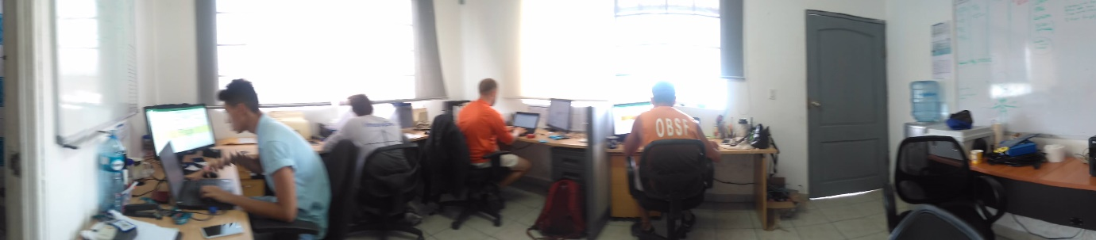
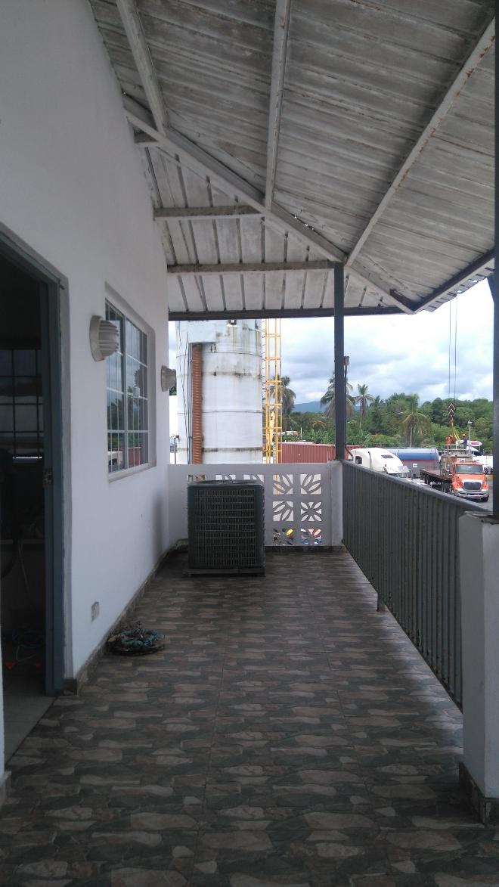
OPEN BLUE OFFICE
ON 19 JUNE 2017

Slide 3
OPEN BLUE OFFICE
ON 19 JUNE 2017
WORKS WE PROPOSE TO IMPROVE THE OFFICE:
REMOVE AND LOCATE IN A BETTER PLACE, THE AIR CONDITIONING MACHINE.
DEMOLITION OF THE EXISTING WALL MARKED IN THE DRAWING, TO ENLARGE THE EXISTING SPACE, SO WE CAN HAVE MORE POSTS OF WORK (6), AND A LOBBY.
CHANGE THE EXISTING FURNITURE TO GIVE IT A FRESH LOOK AND ORGANIZED APPEARANCE TO THE OFFICE.
IN CASE ON WE ‘LL MAKE THE NEW DESIGN , WE HAVE TO REUBICATE THE NEW ELECTRIC OUTPUTS.

Slide 4
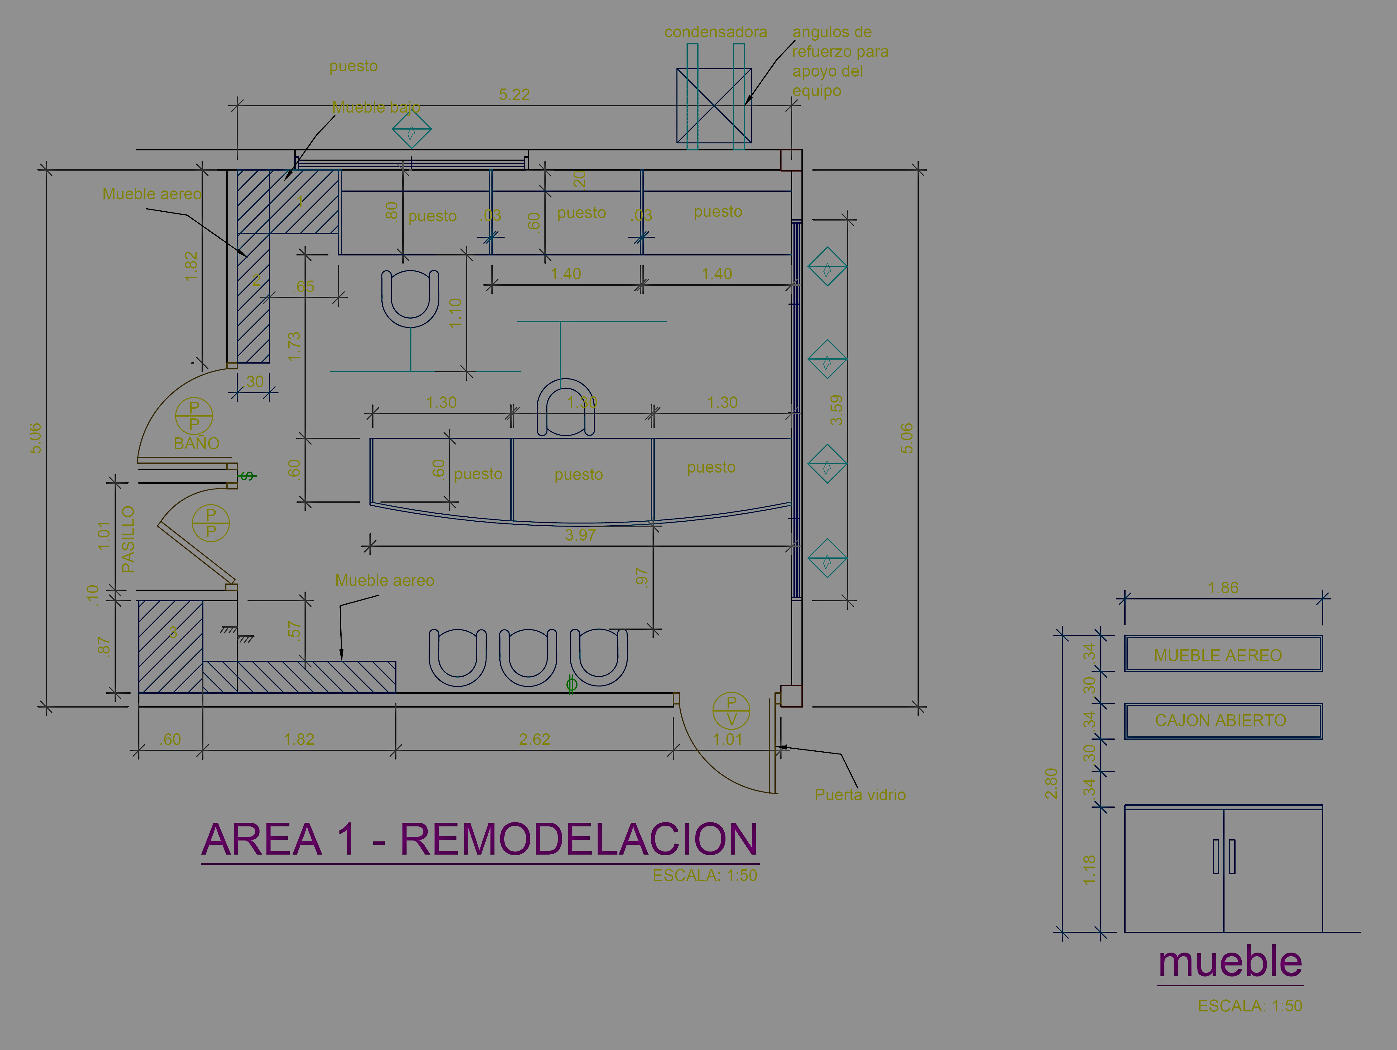
AREA 1 DESIGN PROPOSAL

Slide 5
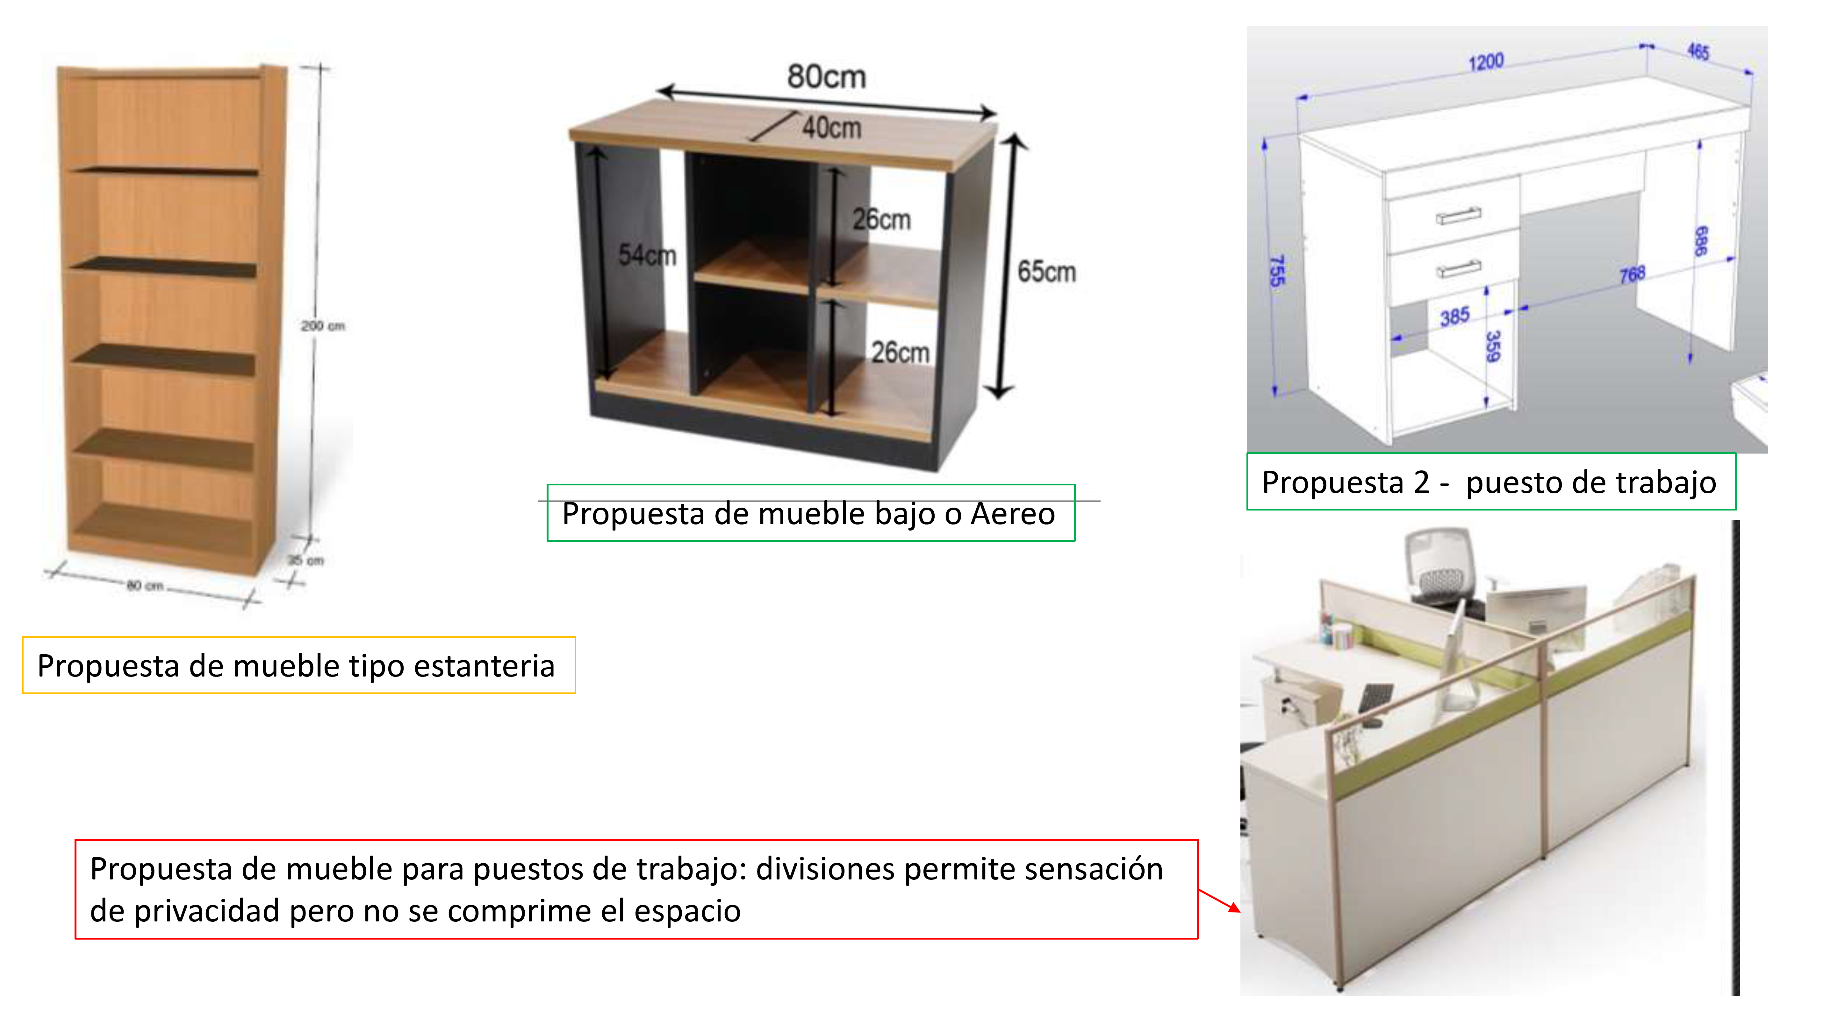
AREA 1 DESIGN PROPOSAL

Slide 6
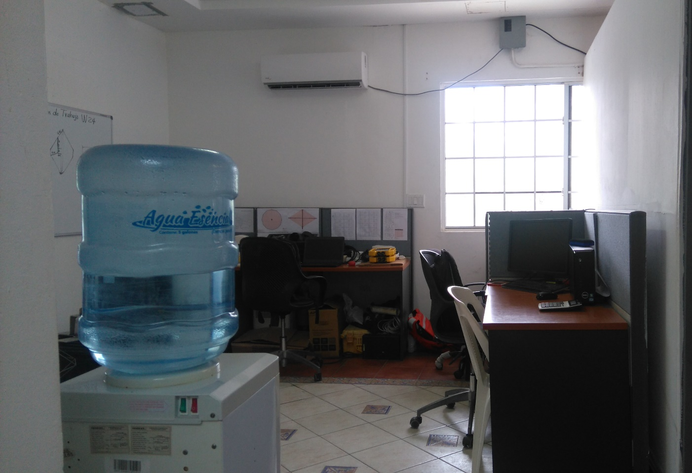
AREA 2 DESIGN PROPOSAL

Slide 7
AREA 2 DESIGN PROPOSAL
WORKS WE PROPOSE TO IMPROVE THE OFFICE:
CHANGE THE FURNITURES.
WE PROPOSE TO USED THE SAME FURNITURES THAT WE PROPOSE FOR THE AREA 1.
WE ARE GOING TO PROPOSE 5 SITES FOR WORK.
COFFEE TABLE AREA.

Slide 8
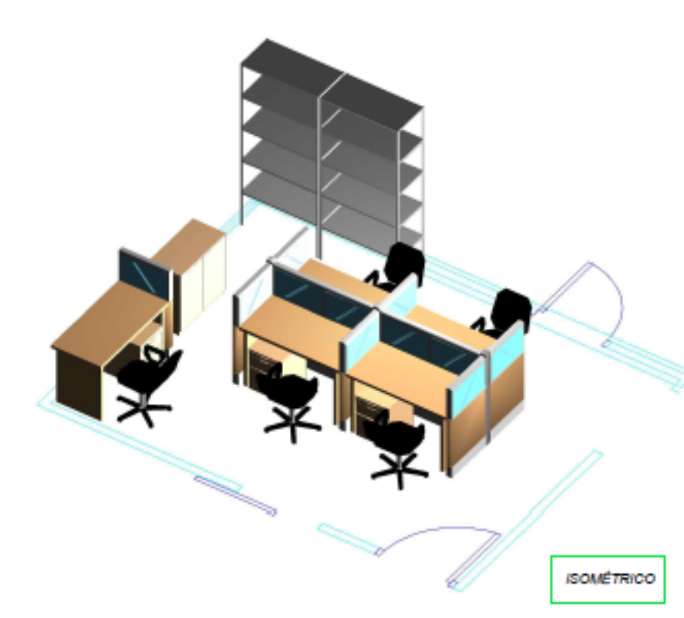
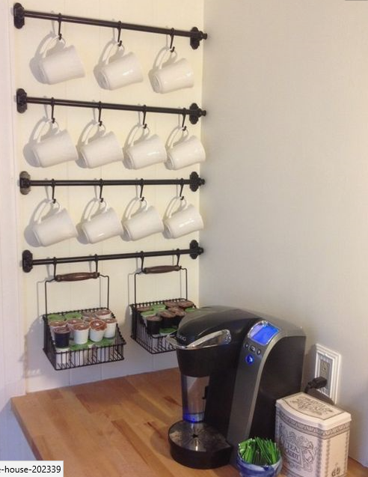
AREA 2 DESIGN PROPOSAL
COFFEE TABLE

Slide 9
AREA 2 DESIGN PROPOSAL

Slide 10
THANK YOU!

